Slide 1
News Summarization Website
By: Thomas Lazarus

Slide 2
Abstract
Due to the amount of daily news thrown at everyone everyday many people do not feel that they have the time to properly read and digest the news. The purpose of the project was to create a simple and efficient way to digest the daily news. This will be done using Google’s Pegasus text generation model.

Slide 3
Requirements
Website must be easy to traverse and efficient
Website must update at least once a day
The backend of the website should preform the summarization as efficiently as possible

Slide 4
Technology
Docker
Django
Python
PyTorch
BeautifulSoup

Slide 5
Challenges
Differences in RSS feeds
The Verge
NY Times
Wired
The Onion
PySpark
Parallelization
Memory Usage
Deployment

Slide 6
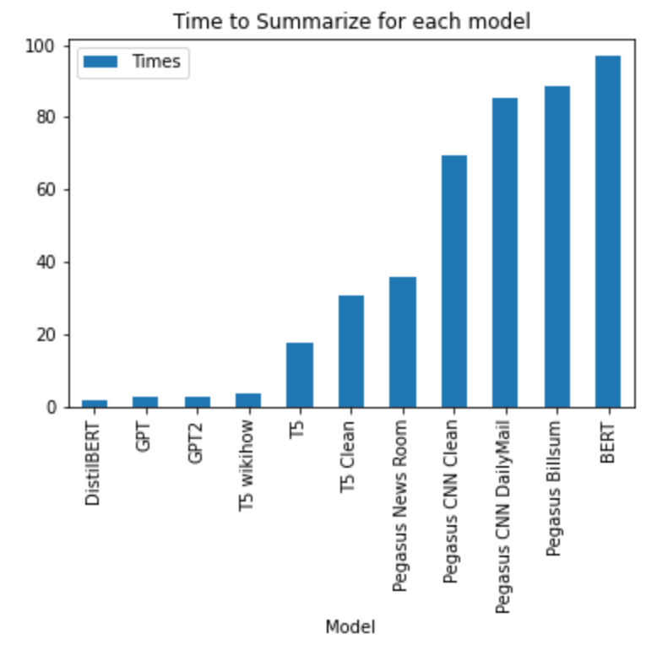
Model Comparison
T5
Time: 17.09 seconds
BERT
Time: 95.76 seconds
GPT
Time: 2.64 seconds
DistilBERT
Time: 1.774 seconds
GPT2
Time: 2.82
T5 Wikihow
Time: 3.58 seconds
Pegasus NewsRoom
Time: 25.58 seconds
Pegasus CNN Daily Mail
Time: 85.2 seconds
Pegasus CNN Daily Mail Clean
78.4 seconds
Pegasus Billsum
Time: 88.43

Slide 7
Google Pegasus Rouge scores
ROUGE-1
f: 0.16925733857863454
r: 0.09315589353612168
ROUGE-2
f: 0.1559792011329743
r: 0.08571428571428572
ROUGE-L
f: 0.2305295927873371
r: 0.13214285714285715

Slide 8
Live Demo

Slide 9
Previous TimeLine
Milestone 1: Proof of Concept Notebook (09/06/2020)
Milestone 2: Web Scraper Implemented (09/19/2020)
Milestone 3: Data Preprocessing Implemented (10/02/2020)
Milestone 4: Model Built/Trained (10/13/2020)
Milestone 5: Front-End Built (11/17/2020)

Slide 10
Areas of Improvement
Efficiency
Currently takes close to 30 minutes for web server to start. Users would never see this when visiting the site but when starting the server it takes a bit.
Front-End
Better Colors
A Header
Add Daily Email

Slide 11
Questions?

